Slide 1




Interactive Data Visualization Dashboard
DSC 680
Jeffery Peterson
May 30, 2020

Slide 2

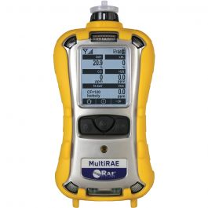
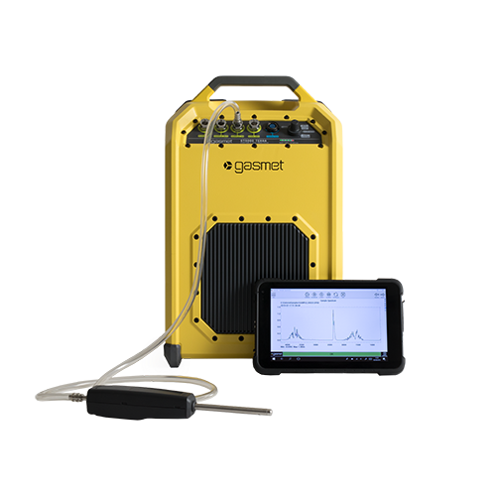
Background
This project was done in support of my work
A recent test collected data from 32 RAE instruments and four GASMET instruments
Traditionally, we print out individual concentration profiles for each timestamp
Tableau will be used to provide a better way to visualize the data
RAE Instrument
GASMET Instrument

Slide 3
Methods
Construct the data files
Build the quad chart visualizations
Build the interactive elements
Visualization deployment
Future plans

Slide 4
Constructing the Data Files
All of the files were built in Excel
The RAE and GASMET instruments collect data in csv format
Tableau can easily ingest Excel files
Could have used Python/R but that would have required unnecessary back and forth between formats
Shouldn’t be afraid to use Excel when warranted

Slide 5
Elapsed time_sync File
I created this file manually
Simple elapsed time column
hh:mm:ss format
Needed as a “join” element for the other data files

Slide 6
T1A File
This file was generated by the GASMET instrument
T1A refers to the trial name
Time: timestamp of trial
Point: label of each of the four instruments
Diethyl sulfide: measured concentration of chemical
Iso-valeric acid: measured concentration of chemical
t-butyl mercaptan: measured concentration of chemical

Slide 7
Test Plot for Color Changing Data Points_T1A File
This file contains instrument generated data as well as data that I manually created
Elapsed Time: this is a column I made that has values between 1-60
X: I made this column to serve as an x-axis position marker for the instruments
Y: I made this column to serve as an y-axis position marker for the instruments
Point: I made this column that lists the individual instruments
Maximum Concentration: this is an instrument generated value of the maximum measured concentration
ET: this is an instrument generated file of elapsed time

Slide 8
MAX MIN AVERAGE_T1A File
This file contains instrument generated data as well as data that I manually created
Contains T1A High and T1A Low worksheets
Time: this is a column generated by the instruments at 1-minute intervals
Concentration: measured chemical concentration at each timestamp
Point: I made this column that lists the individual instruments
Elapsed Time: this is a column I made of elapsed time

Slide 9
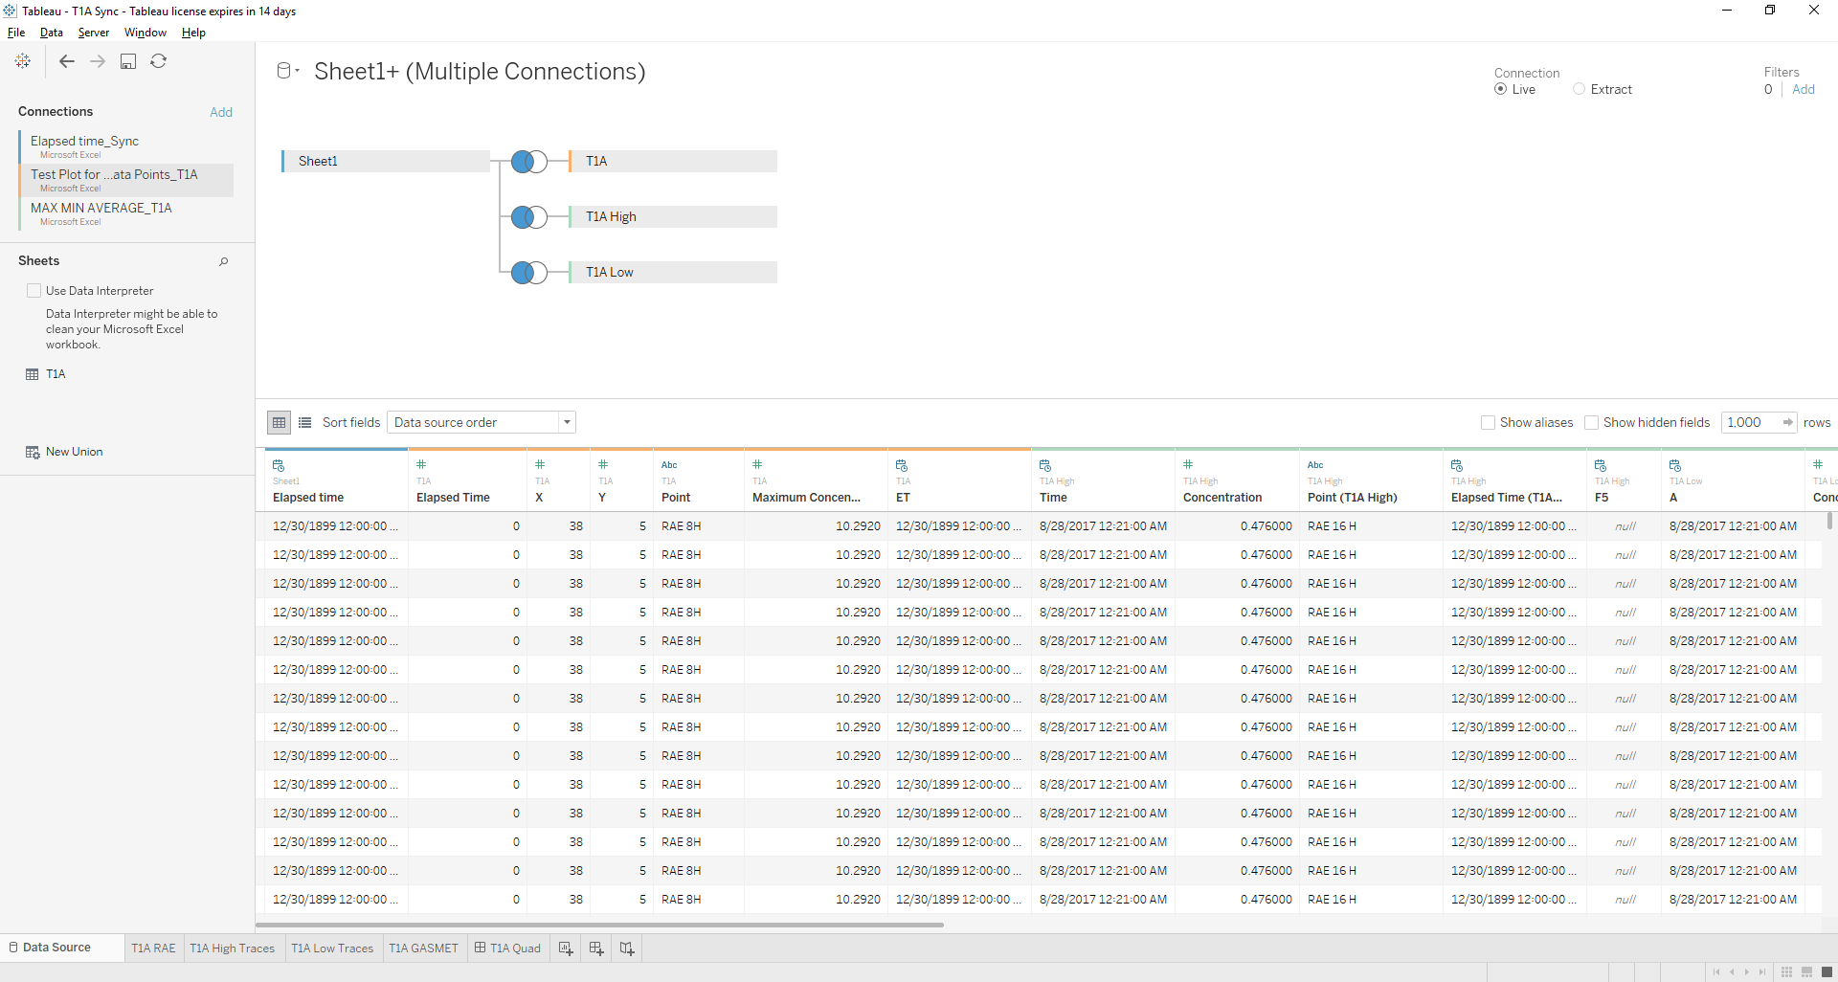
Bringing Data Into Tableau
Data were joined on the Elapsed Time column from the Elapsed time_sync file that I made

Slide 10
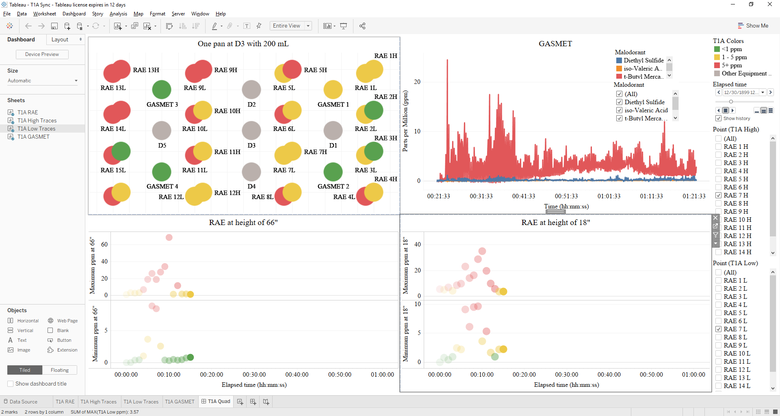
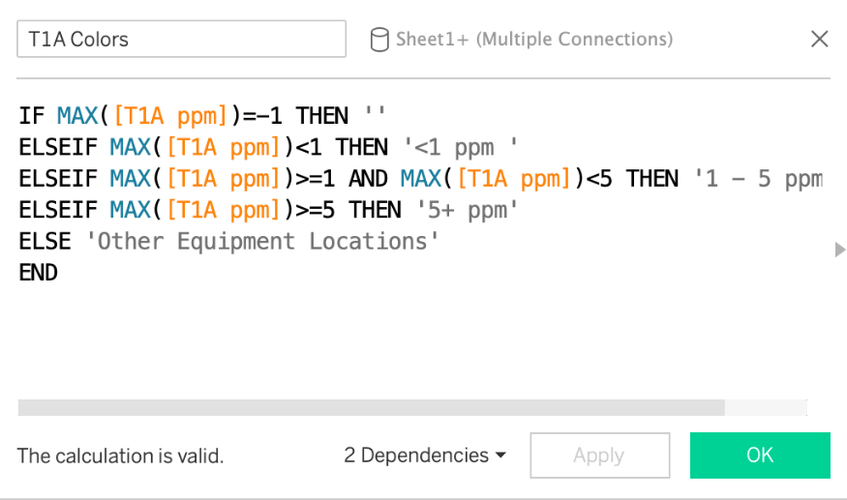
Building Quadrant 1
Top down visualization of the test chamber
32 RAE instruments at 16 different locations
16 at 18” above ground level
16 at 66” above ground level
The instrument icons will change colors based on detected concentrations
<1 ppm = Green
1-5 ppm = Yellow
5+ ppm = Red

Slide 11
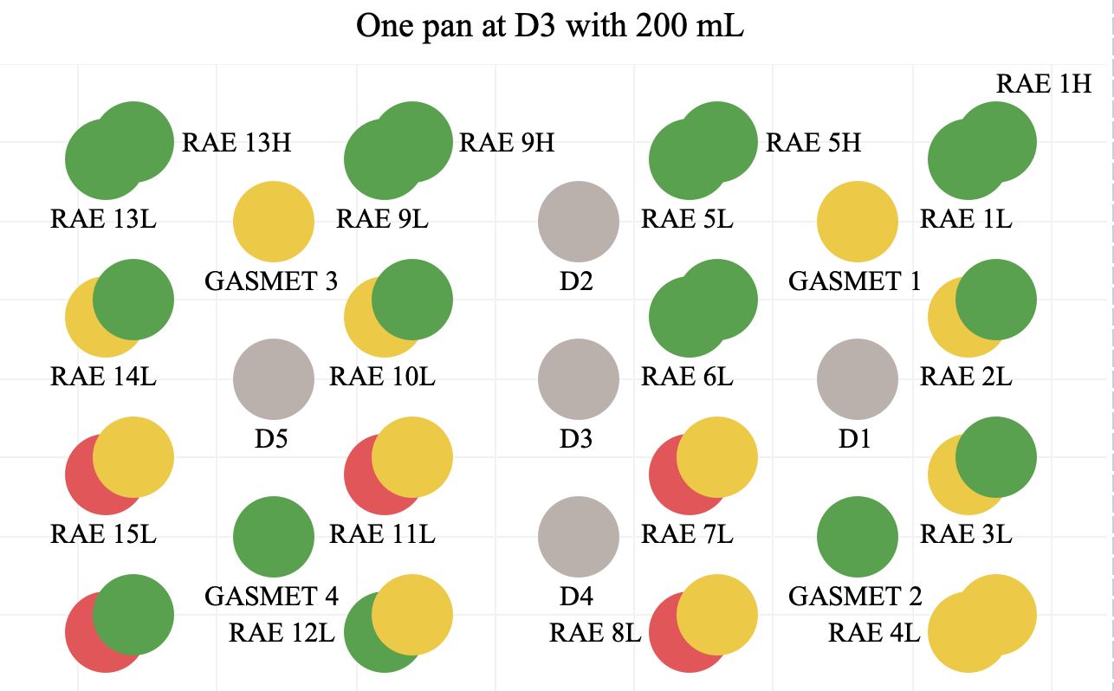
Quadrant 1 Visualization
Here is the final view for the instruments and release locations
The title refers to one chemical release location at D3 with 200 mL of chemical

Slide 12
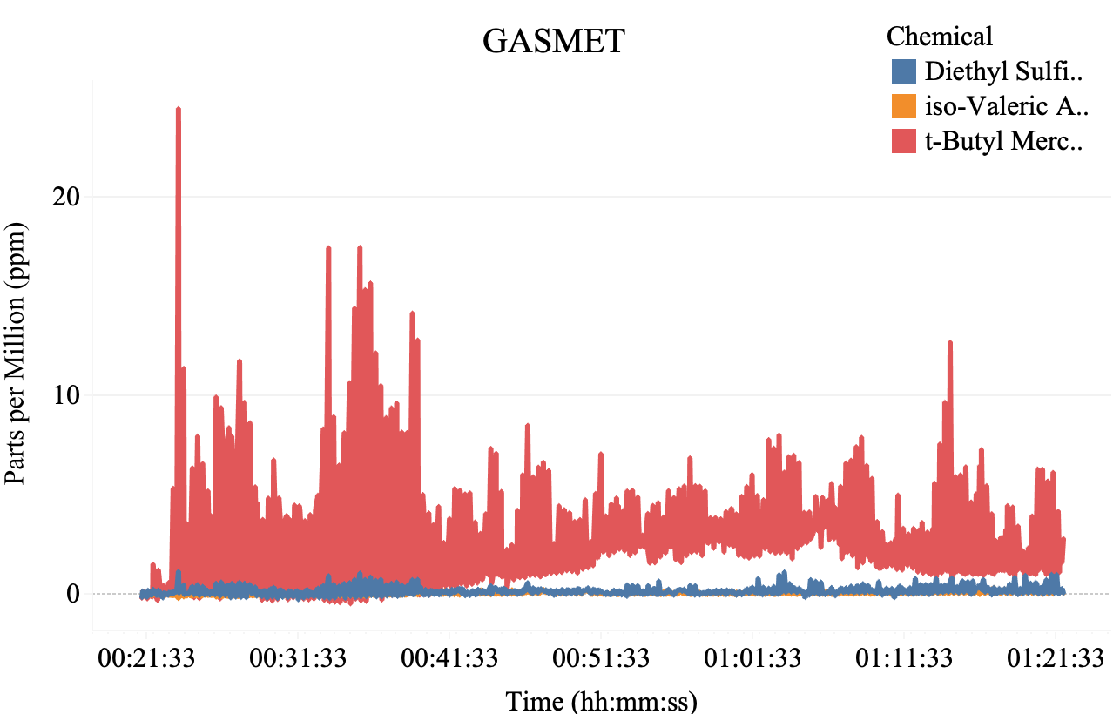
Quadrant 2 Visualization
Simple line plot overlay of three chemical feeds from the GASMET instruments
Cumulative totals from all four instruments

Slide 13
Building Quadrants 3 & 4
Quadrant 3 will display the RAE instrument concentrations at the 18” height
Will have two windows that represent the maximum and minimum concentrations recorded at each timestamp
Quadrant 4 will display the RAE instrument concentrations at the 66” height
Will have two windows that represent the maximum and minimum concentrations recorded at each timestamp
Result will provide a pseudo-cross sectional 3D view in just two dimensions

Slide 14
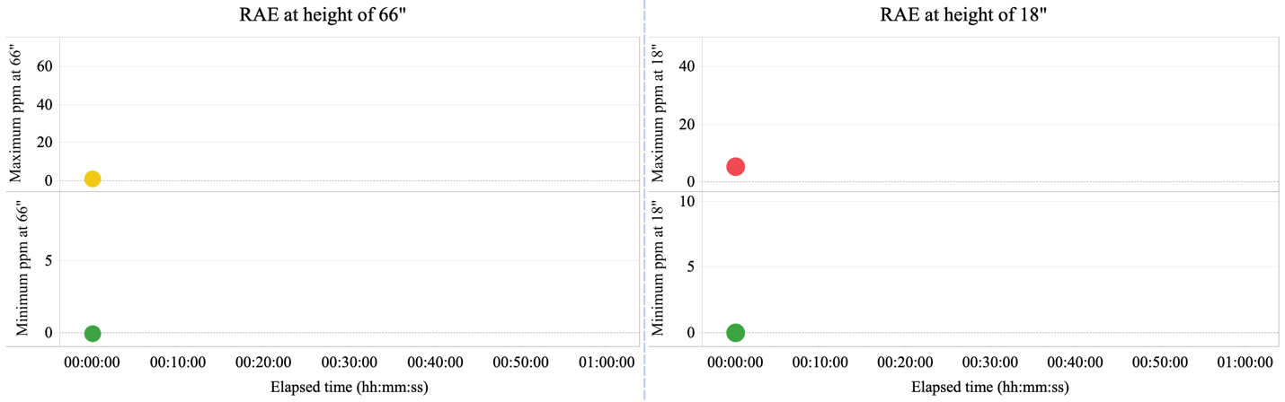
Quadrants 3 & 4 Visualizations
Concentrations will tracked using the color-coded icons

Slide 15
Building the interactive elements
Used the Tableau Pages Shelf to create time-based playback
Concentration for each timestamp is shown as a color-coded icon
Playback is synced for each dashboard quadrant
The “Show History” box is checked in playback control window to show historic concentration levels for quadrants 3 and 4
Quadrants 3 and 4 have instrument toggles
Allows user to select the individual instrument concentrations
Concentrations are summed when multiple instruments are selected

Slide 16
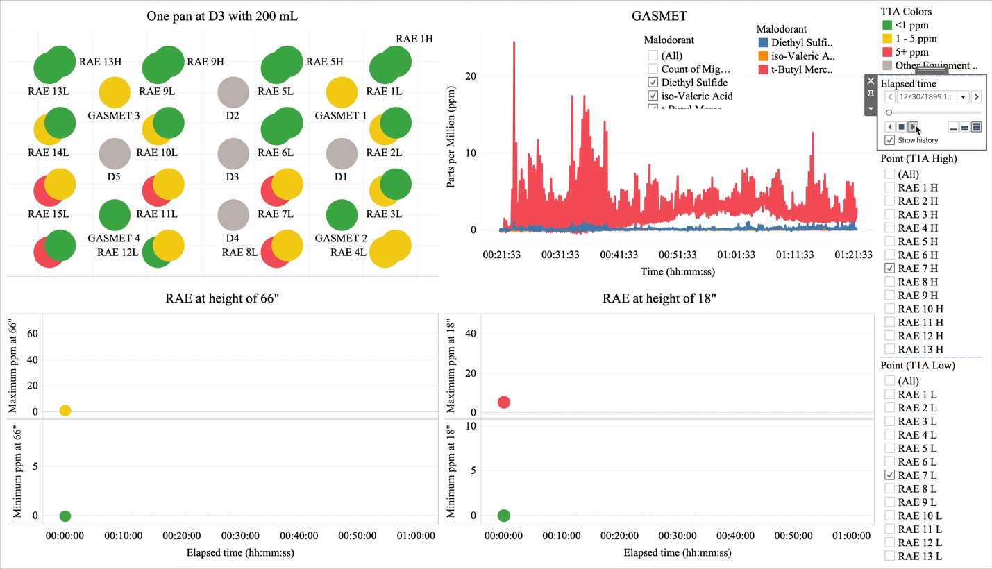
Final Visualization

Slide 17
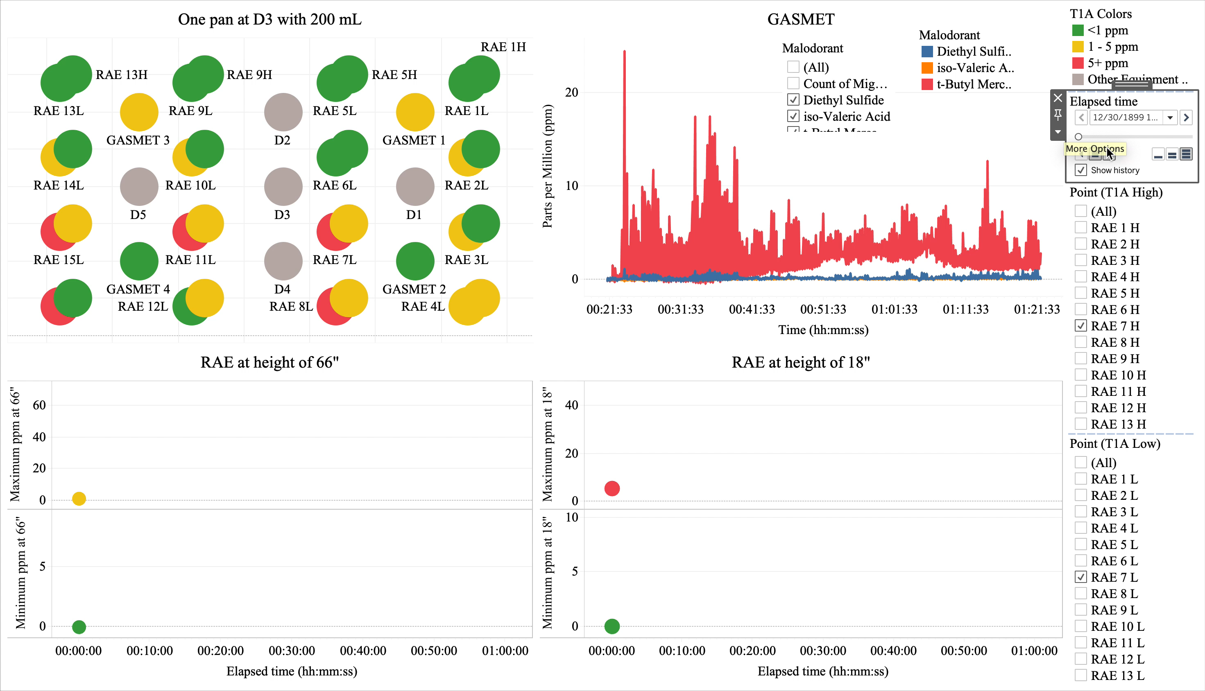
Visualization Demonstration

Slide 18
Visualization Deployment
I obtained an account on the Department of Defense Tableau Server
The visualization was posted on this secure site
Allows me to control distribution and access
Users must have a Common Access Card (CAC) to login
Allows us to post sensitive information
Feedback has been very positive

Slide 19
Future work
My work purchased three Tableau licenses as a result of this project
Management has request that I build other visualizations

